Slide 1

Version 1.1
8/10/2019

Slide 2

We make it easy for the right students to be matched with the right employers

Slide 3



PROBLEM
45.3%
of students don’t use anything to track intern/grad roles
76.7%
of students forget to apply for intern/grad roles
92%
of students don’t enjoy applying for intern/grad roles
Disorganised
Missed Opportunities
Overwhelmed

Slide 4



SOLUTION
Underlying Need | Feature | % of students desire this
Organise | Track your applications | 90%
 | Personalised Job List | 87.6%
Automate | Alerts | 80.2%
 | Auto-Apply | 75.3%
Insight | Reviews | 95%
 | Forums | 79%
 | Success Rate Prediction | 72.8%
Notes:
3 strategic pillars

Slide 5
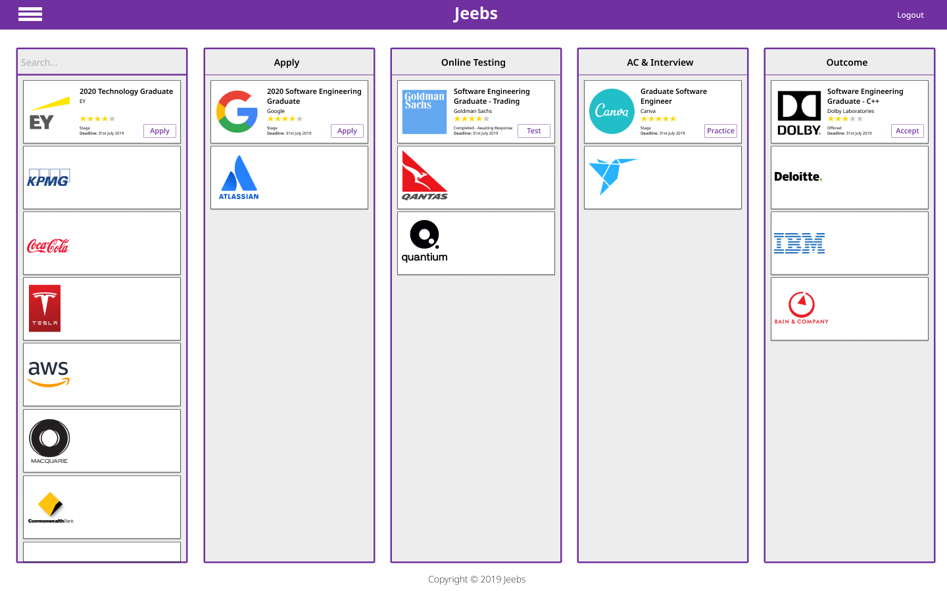
CORE FEATURE 1 - CENTRALISED LISTINGS W/ TRACKER

Slide 6




CORE FEATURE 2 - SUCCESS RATE PREDICTION
Academic
Transcript
Psychometric
Testing
2020 - Investment Banking Graduate Program
How you can boost your score:
Join BusinessOne Consulting
Participate in the upcoming Microsoft Protege
Complete volunteer work with Red Cross
Take FINS3650 as an elective
Learn Excel VBA Macros
Resume
86/100
Sam Williams
Notes:
Create a caste study on this

Slide 7

CORE FEATURE 3 - FORUMS
EY - 2020 Graduate Program
Marcus | Hey when does the assessment centre normally happen?
George from EY | Hey Marcus, the assessment centre normally runs in July
Marcus | Awesome thanks!
Emma | Any tips for phone interview?
Jennifer | I did the phone interview last year, they just ask about your motivation for joining EY
Emma | Okay, doesn’t sound too bad. Thanks for the info! :)
Notes:
3 strategic pillars

Slide 8







COMPETITION
Features Students Want
Centralised Listings
Forums
Reviews
Calendar Sync
Application Tracking
Personalised Job List
Alerts
Auto/Easy/Quick-Apply
Success Rate Prediction
Notes:
% of students that want each feature

Slide 9
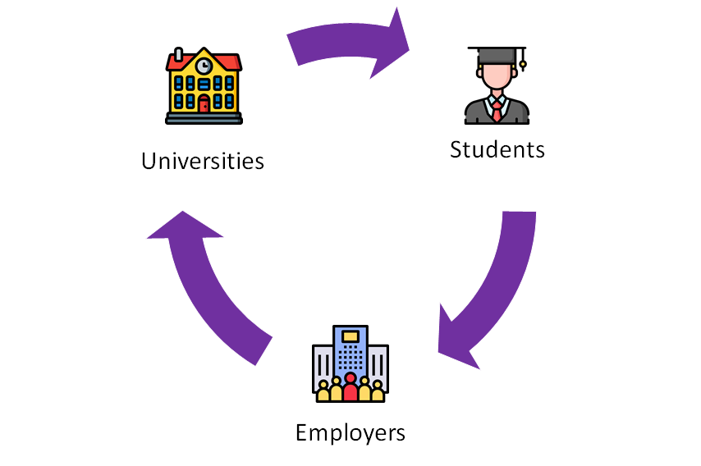
BENEFITS
Students apply for more jobs that match their skills, interest and personality
Universities increase employment rate of their grads
Employers recruit more students with the right fit
Notes:
SCALABLE

Slide 10


BUSINESS MODEL
Employers
Universities
Stage 1 (+ 6 months)
Job Listing
$500/post
Stage 1 (+ 6 months)
Centralised Careers Portal
$10/student
Stage 2 (+ 1 year)
Recruitment Bundle
(Applicant Ranker & Scheduler)
$4000/month

Slide 11
MARKET
Global
$4B
$5.2B
ANNUAL GLOBAL MARKET SIZE
Global
$1.2B
Australia
$73M
$86M
AUS MARKET SIZE
Australia
$13M
Employers
Universities
Notes:
https://www.universityrankings.com.au/university-student-numbers.html

Slide 12





GO-TO-MARKET STRATEGY
10,000 Users
by May 2020
Step 4
Step 3
UNSW Launch Event
X
Uni Societies
Step 2
Flyers
Step 1
Social Media
Email Database
Notes:
Alternative: Step 4: launch at O-week

Slide 13


TEAM
Rohan Jain Co-founder
Michael Ho
Co-founder

Slide 14
Appendix

Slide 15




ROADMAP
6 month
1 year
2 year
3 year
5 year
First Release
MVP
Growth Hack
10,000 users
Charge Uni’s & Employers
Enter Global
Market
Acquisition/IPO
Notes:
change first release to 6 month, growth hack 1 year, charge 2 yr, keep rest the same

Slide 16
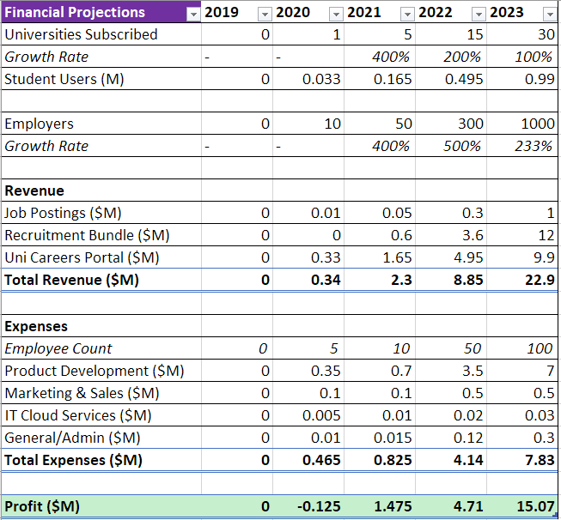
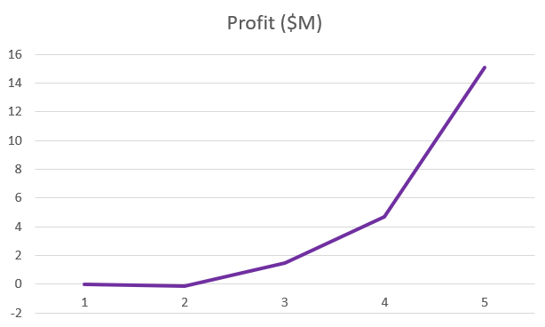
FINANCIALS

Slide 17



AMOUNT BEING RAISED
$500K
Product Development
$350K
Marketing & Sales
$100K
General Expenses
$50K
Notes:
100k is reasonable

Slide 18
MARKET DATA
1,313,776 Students in Australia
39 Universities in Australia
56,700,000 Students globally
Value of job listing in Australia
# of internships/grad programmes in Australia
Gradconnection $1500 (australia wide) for 30 days
Linkedin $2-$5 per click
Seek $285
Indeed $0.10 to $5 per click
Jora $500 per month
Market size $ of Australia
Global market size
Notes:
https://www.universityrankings.com.au/university-student-numbers.html

Slide 19
Market Size & Financial Calculations
Employers
Australia
$500/post
1500 employers
3000 grad/intern posts
$500 x 3000 = $900k
$4000/month
$48k/year
$48k x 1500 = $72M
Total = $73M
Global
129,474 grad/intern posts
$500 x 129,747 = $64.7M
$48k x 64,737 = $3B
Total = $4B
Universities
Australia
$10/student
1,313,776 students
Total = $13.1M
Global
$10/student
117M students
Total = $1.17B
Assumptions
Students/Uni | 33000
% of employers subscribing to recruitment bundle | 25%
Job Posting Price | $500
Recruitment Bundle Price/month | $4,000
Price/Student for Careers Portal | $10
Avg salary of employees | $70,000
General & Admin = | Mostly Rent

